Slide 1
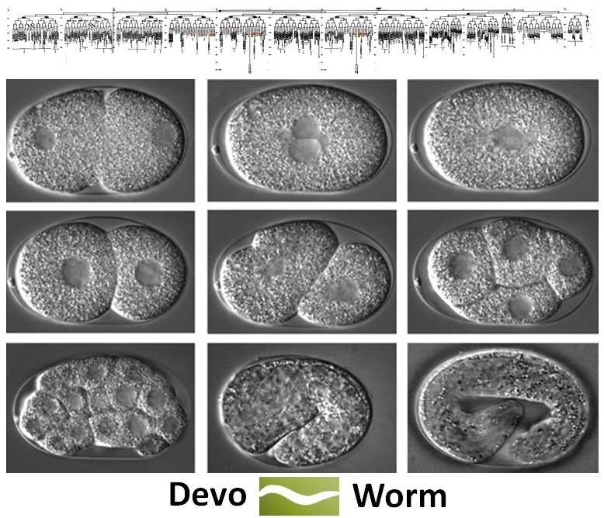
DevoWorm: reconstructing development as bits and datatypes
Bradly Alicea, Steve McGrew, Stephen Larson, Mark Watts, Tim Warrington, and Richard Gordon
August xx, 2014 OpenWorm Journal Club

Slide 2
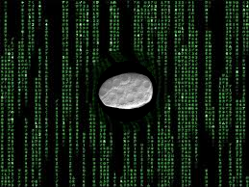
Hacking the Organism, or Hacking the Scientific Interpretation?
DevoWorm is a rare combination:
DEVELOPMENTAL (in silico) HACKING: we want to extend the accomplishments of OpenWorm by focusing on development. Insight through data structures. A model for potential experimental manipulation.

Slide 3
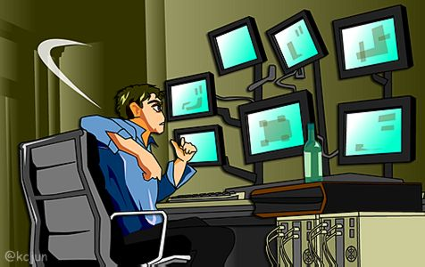
Hacking the Organism, or Hacking the Scientific Interpretation?
DevoWorm is a rare combination:
DEVELOPMENTAL (In silico) HACKING: we want to extend the accomplishments of OpenWorm by focusing on development. Insight through data structures. A model for potential experimental manipulation.
INTERPRETIVE HACKING: we want to better understand the generative process of development. This can be done via theoretical constructs.

Slide 4
Why are we interested in C. elegans development?

Slide 5
Why C. elegans? Unique Properties
Embryogenesis is analytically tractable:
* C. elegans has 959 cells in adult hermaphrodite, 1031 in adult male¹.
* roughly 850 cells are unique, 50 pairs are equivalent pairs².
¹ Wood, W.B. The Nematode Caenorhabditis elegans. Cold Spring Harbor Monograph, Volume 17 (1988).
² Sulston, J.E. and Horvitz, H.R. Post-embryonic cell lineages of the nematode, Caenorhabditis elegans. Developmental Biology, 56(1), 110–156 (1977).

Slide 6
Why C. elegans? Unique Properties
Embryogenesis is analytically tractable:
* C. elegans has 959 cells in adult hermaphrodite, 1031 in adult male.
* roughly 850 cells are unique, 50 pairs are equivalent pairs.
C. elegans is eutelic: each adult individual in species has a fixed number of cells.
* each lineage consists of founder cells³ and descendents.
* cell lineages are invariant across individuals (small differences between males and hermaphrodites).
³ Cells capable of establishing a lineage (e.g. giving rise to progenitor cells).

Slide 7
Why C. elegans? Unique Properties
Embryogenesis is analytically tractable:
* C. elegans has 959 cells in adult hermaphrodite, 1031 in adult male.
* roughly 850 cells are unique, 50 pairs are equivalent pairs.
C. elegans is eutelic: each adult individual in species has a fixed number of cells.
* each lineage consists of founder cells and descendents.
* cell lineages are invariant across individuals (small differences between males and hermaphrodites).
Two other features of C. elegans development are ripe for revisitation:
* development is generative but invariant. How does this happen?
* detailed accounting of developmental symmetry along three axes.

Slide 8
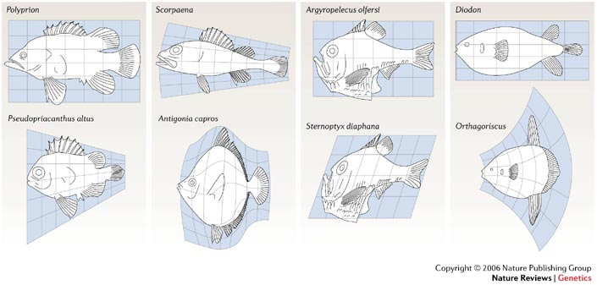
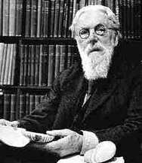
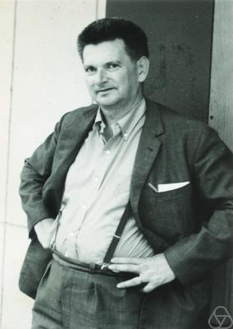
Why Development? From “is” to “how”
Development (and evolution) provides us with indispensible information about the organism:
D’Arcy Thompson (On Growth and Form), Rene Thom (Structural Stability and Morphogenesis): diversity of structure understood as a series of isomorphic mappings.
* Historical constraints give rise to structure, in turn give rise to functional diversity and limitations (what is and is not possible).
COURTESY: Wallace Arthur, Nature Reviews Genetics 7, 401-406 (2006).

Slide 9
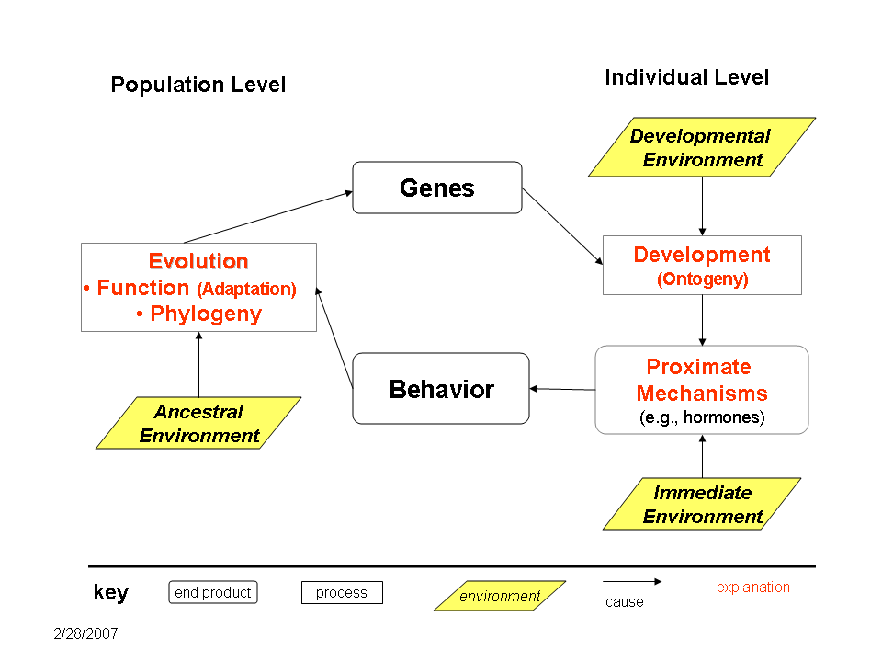
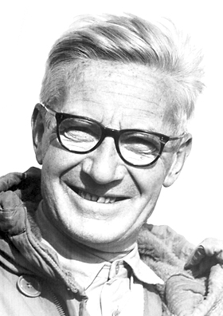
Why Development? From “is” to “how”
Niko Tinbergen: one way to understand function is to understand how traits arise in development.
* Provides a layer of relational information not immediately apparent from adult morphology and genetics.

Slide 10
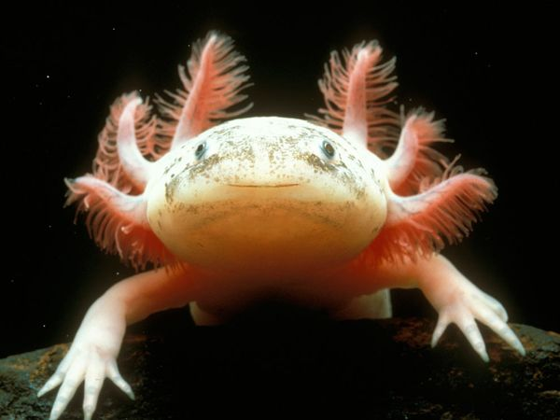
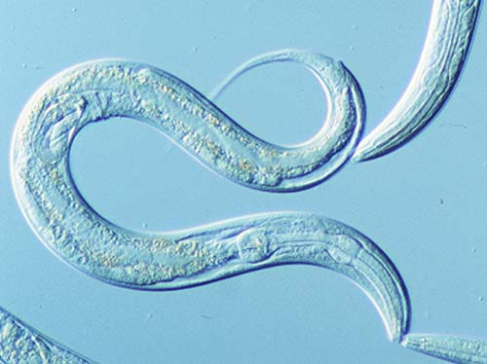
Regulative vs. Mosaic Development
Activation of cell state splitters have slightly different types of effects in mosaic embryos (e.g. worms).
* originally based on observations of regulative embryos (e.g. axolotls).

Slide 11
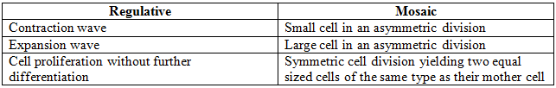
Regulative vs. Mosaic Development
Activation of cell state splitters have slightly different types of effects in mosaic embryos (e.g. worms).
* originally based on observations of regulative embryos (e.g. axolotls).

Slide 12
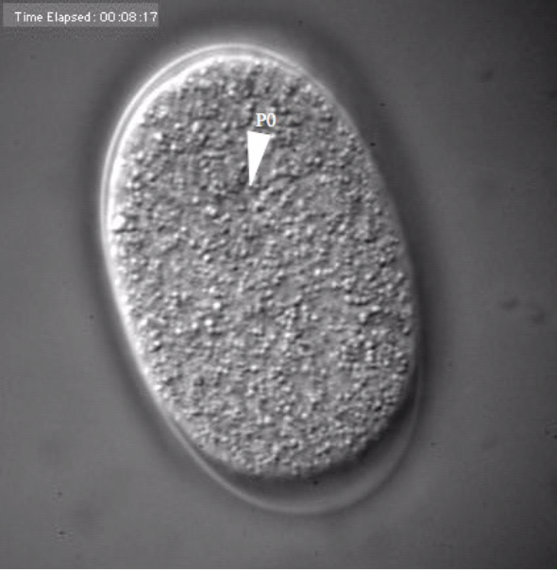
C. Elegans
Embryogenesis (from sphere to worm)
P0 originates from male-female gonadal stage.

Slide 13
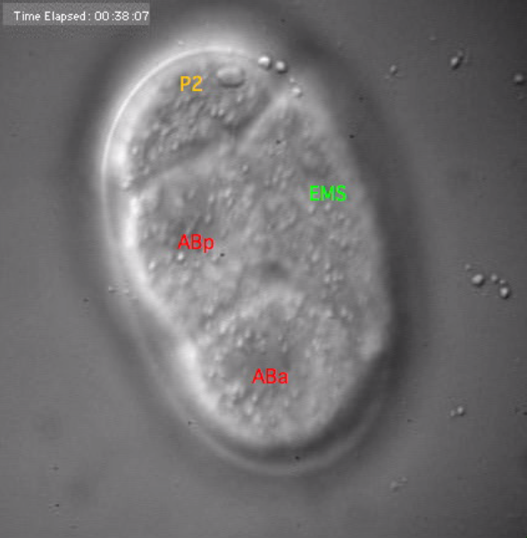
Four founder cells
(two divisions)

Slide 14
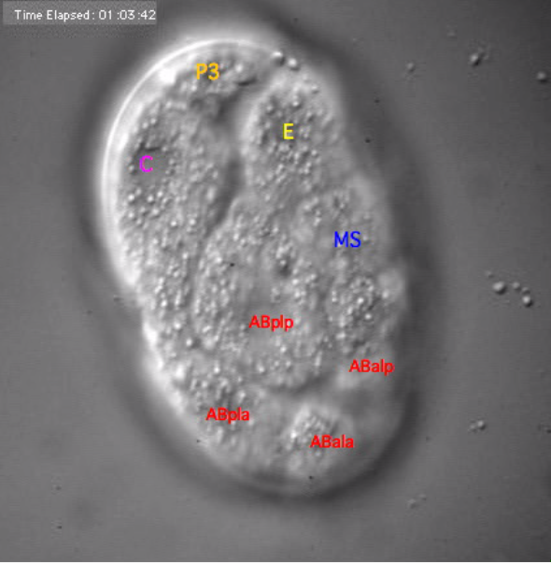


Four cells in AB lineage
(two divisions)

Slide 15
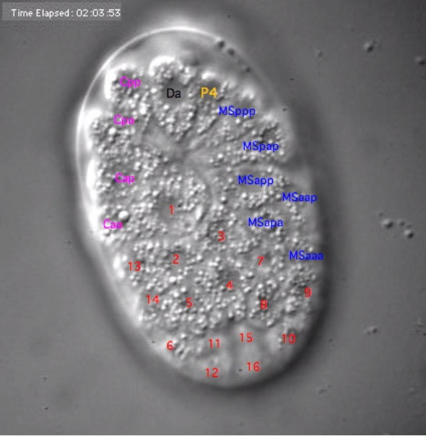

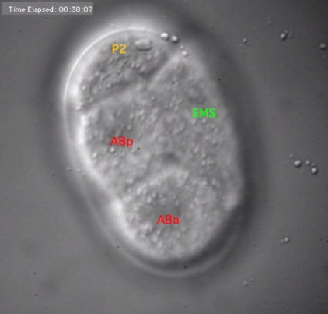
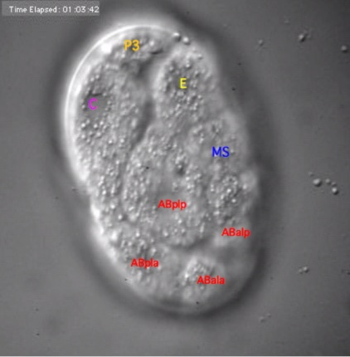
Six cells in MS lineage
(three divisions)

Slide 16

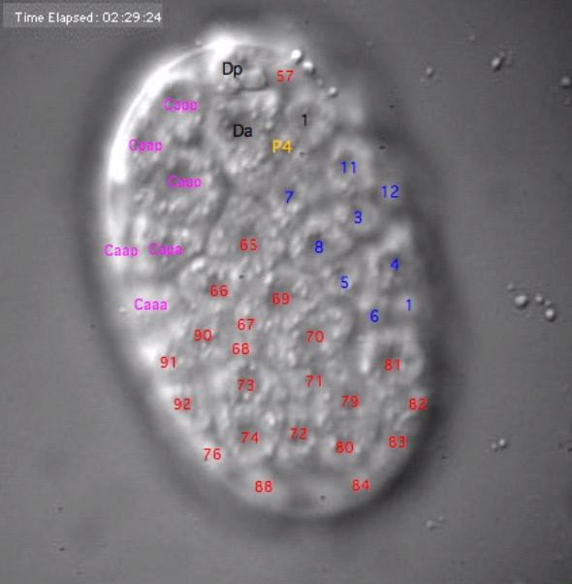


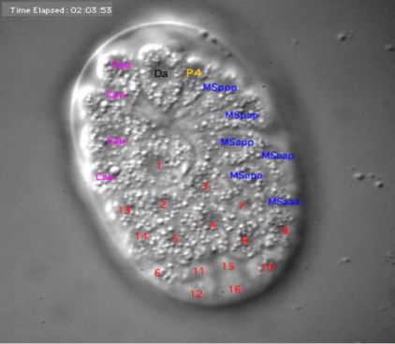
COURTESY: White Lab and Sharon (Fong-Mei) Lu, University of Wisconsin (flu2@wisc.edu).

Slide 17
The first four cells in the AB lineage:
Placement: 1) posterior left anterior, 2) posterior left posterior, 3) anterior left posterior, 4) anterior left anterior.
Original founder cell is no longer there.
* three axes of embryogenesis: anterior- posterior, left-right, dorsal- ventral.
C. elegans (unlike Mammalian embryos) have a specified pattern of embryogenesis.
* recall that cell fate is deterministic and environmentally-invariant.

Slide 18
How to Understand Development in Terms of Emulation and Theoretical Constructs

Slide 19
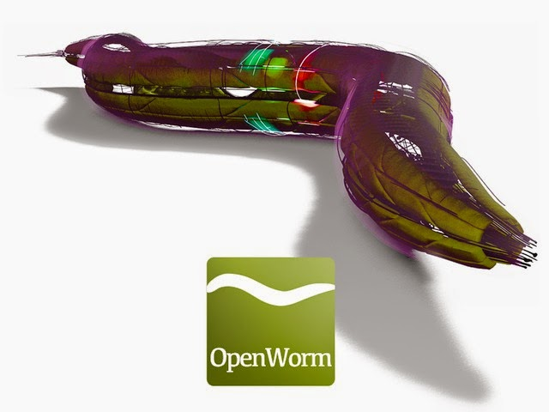
In the beginning, there was vision for whole-organism emulation (and it was good)
The initial conception was Cyberworm⁴
OpenWorm provides a basis for understanding the adult C. elegans and its nervous system
⁴ Gordon, R. (1999). The Hierarchical Genome and Differentiation Waves: Novel Unification of Development, Genetics and Evolution. Singapore & London, World Scientific & Imperial College Press. http://www.worldscientific.com/worldscibooks/10.1142/2755

Slide 20
In the beginning, there was vision for whole-organism emulation (and it was good)
The initial conception was Cyberworm⁴
OpenWorm provides a basis for understanding the adult C. elegans and its nervous system
Lineage trees (Sulston et al., 1980) are an excellent means to an end, but do not describe the developmental process (embryogenesis) very well. There is a need to re-interpret how development unfolds.

Slide 21
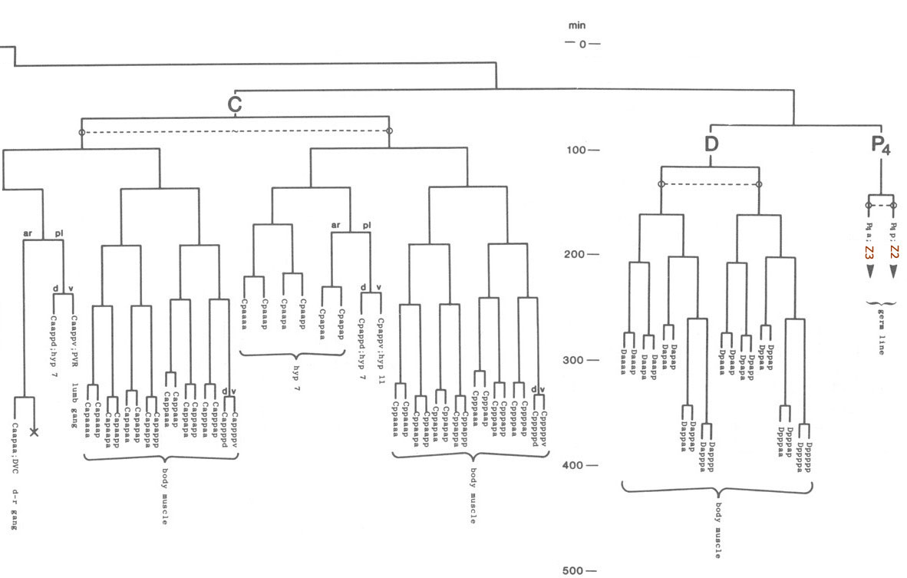
PROBLEM: lineage trees are merely descriptive, provide a “whom begat whom” view of development.
* branching process is actually multi-dimensional (L-R, A-P, D-V).
* each lineage contains descendents of the parent (e.g. AB parent, ABlrrpvva descendent).

Slide 22
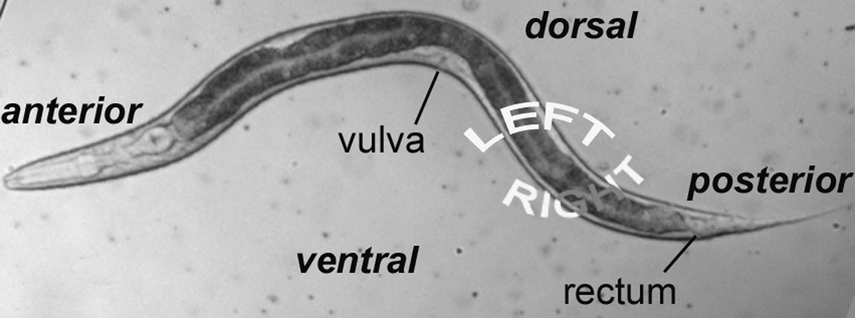
PROBLEM: lineage trees are merely descriptive, provide a “whom begat whom” view of development.
* branching process is actually multi-dimensional (L-R, A-P, D-V).
* Lineage trees are organized along only one of these axes (anterior-posterior).
COURTESY: Yochem, J. Nomarski images for learning the anatomy,
with tips for mosaic analysis. Chapter 1, WormBook.

Slide 23
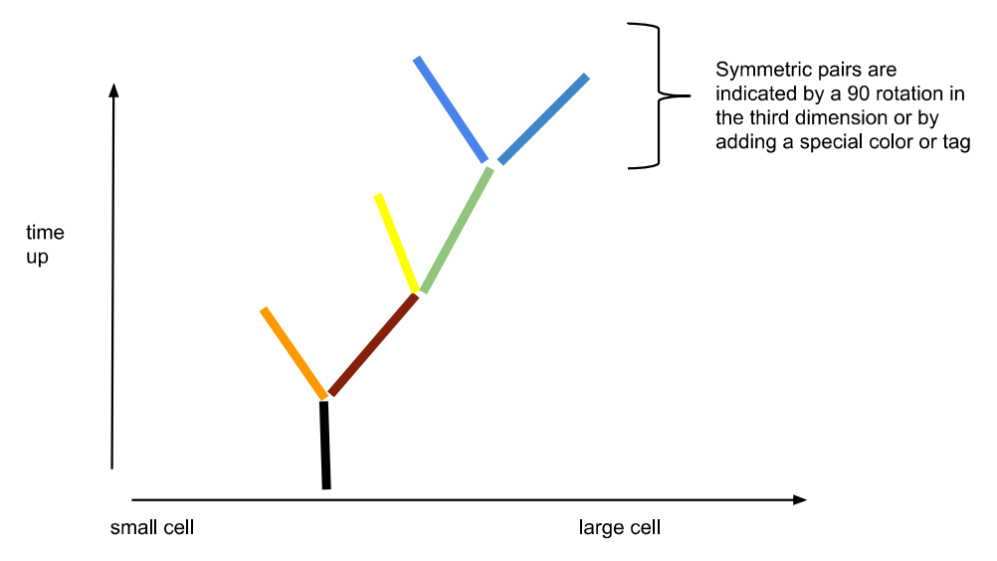
SOLUTION: use the same information to construct a differentiation tree.
Organize cells from small to large:
* cell divisions (lineage branching) over time.
* symmetry = 90 degree rotation in the third dimension (dorsal-ventral).
Two technical problems (developmental and computational):
* How do we represent multivariate attributes of branching lineages?
* How do we integrate a multitude of datatypes ?
D-V symmetrical
division
L-R division

Slide 24
Differentiation Trees
Seeing the trees through the forest of an epigenetic landscape (sensu Waddington). But why do we need to use differentiation trees when we already have a lineage tree?

Slide 25
Differentiation Trees
Differentiation trees are based on the presence of expansion and contraction waves triggered by cell state splitter activity in individual cells.
* Cell state splitter: cytoskeletal structure hypothesized to send a binary signal (change of state information) to the genome, changing the cell to one of two new cell types (i.e., cell state splitter triggers a step of differentiation).

Slide 26
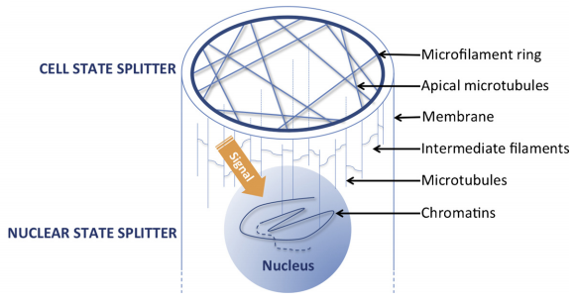
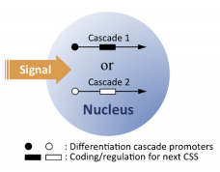
Differentiation Trees
Differentiation trees are based on the presence of expansion and contraction waves triggered by cell state splitter activity in individual cells.
COURTESY: Lu, K., Cao, T., and Gordon, R. A cell state splitter and differentiation wave working-model for embryonic stem cell development and somatic cell epigenetic reprogramming. Biosystems, 109, 390-396 (2012).

Slide 27
What are our assumptions about the biology? Is it fair?
1) Are mechanical signals the only possible mechanism for the cell state splitter?
* in C. elegans, the mechanism could be mechanical, juxtacrine signaling, cell movement, or a combination of factors.

Slide 28
What are our assumptions about the biology? Is it fair?
1) Are mechanical signals the only possible mechanism for the cell state splitter?
* in C. elegans, the mechanism could be mechanical, juxtacrine signaling, cell movement, or a combination of factors.
2) What about the genetic contributions to C. elegans development? Is it fair to exclude most of these relationships?
* using the cell biology of C. elegans development as the basis for our abstraction is the most inclusive approach.

Slide 29
What are our assumptions about the biology? Is it fair?
1) Are mechanical signals the only possible mechanism for the cell state splitter?
* in C. elegans, the mechanism could be mechanical, juxtacrine signaling, cell movement, or a combination of factors.
2) What about the genetic contributions to C. elegans development? Is it fair to exclude most of these relationships?
* using the cell biology of C. elegans development as the basis for our abstraction is the most inclusive approach.
3) How do differentiation trees contribute to our understanding of developmental processes?
* differentiation trees and differentiation waves are an extension of reaction-diffusion morphogenetic models advanced by Turing (more on this later).

Slide 30
Grounding our Theory in The Processes of Development

Slide 31
“All models are wrong, but some are useful”. George Box, Statistician
Our model might well be “wrong” (but useful). But what can we do with it?

Slide 32
“All models are wrong, but some are useful”. George Box, Statistician
Our model might well be “wrong” (but useful). But what can we do with it?
Predict the effects of a mutant phenotype.
* how do mutant phenotypes get produced, and what are the consequences of having a mutant phenotype?
* may require addition of an “evo-devo” simulation (e.g. ALFRED).

Slide 33
“All models are wrong, but some are useful”. George Box, Statistician
Our model might well be “wrong” (but useful). But what can we do with it?
Predict the effects of a mutant phenotype.
* how do mutant phenotypes get produced, and what are the consequences of having a mutant phenotype?
* may require addition of an “evo-devo” simulation (e.g. ALFRED).
2) Make greater generalizations to Eutelic organisms that undergo mosaic development.
* when the structure of a differentiation tree changes, what are the functional consequences?
* requires experimental validation, but would be of great use to experimentalists.

Slide 34
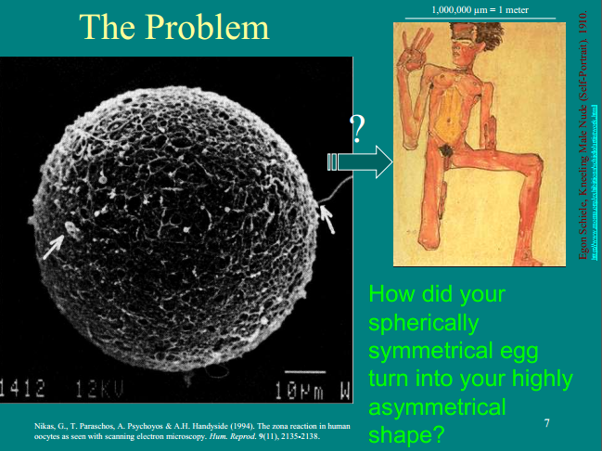

Slide 35
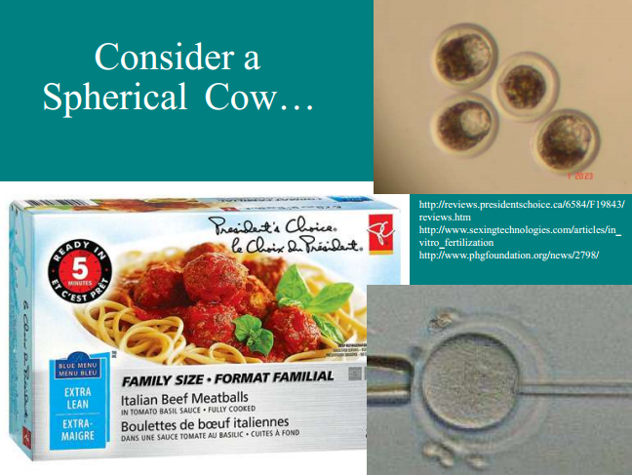

Slide 36
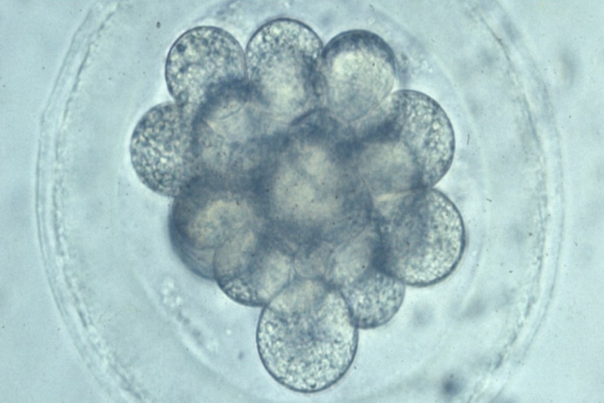
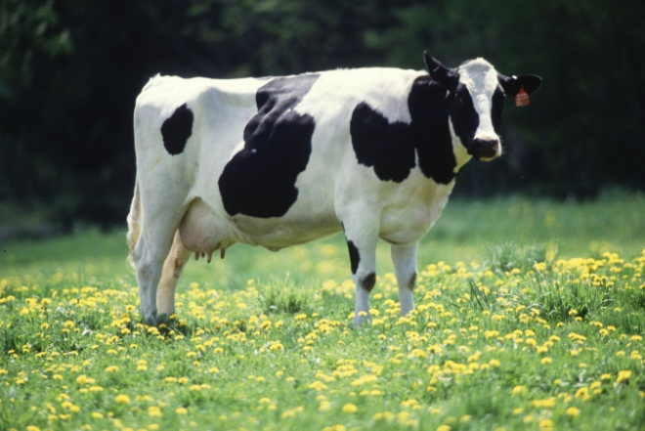
How do we go from A to B?
A
B
In regulative development, B is the outcome of morphogenesis (more general form of embryogenesis). A similar outcome is observed in mosaic development.

Slide 37
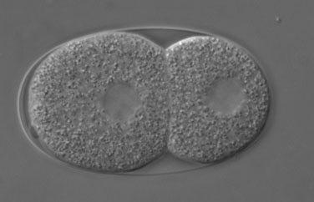
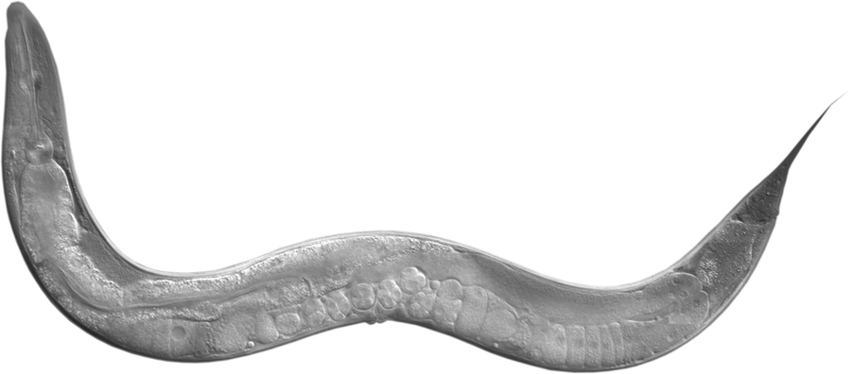
How do we go from A to B?
A
B
In regulative development, B is the outcome of morphogenesis (more general form of embryogenesis). A similar outcome is observed in mosaic development.
A
B

Slide 38
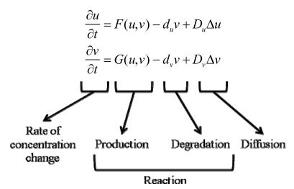
Turing A.M. The chemical basis of morphogenesis. Philosophical Transactions of the Royal Society of London, B237, 37-72 (1952).
Reaction-diffusion morphogenesis: a symmetry-breaking model?
Coupled differential equations produces spatial (gradient) and temporal (pulse) information

Slide 39
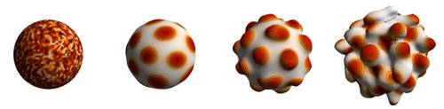
Turing A.M. The chemical basis of morphogenesis. Philosophical Transactions of the Royal Society of London, B237, 37-72 (1952).
Reaction-diffusion morphogenesis: a symmetry-breaking model?
Coupled differential equations produces spatial (gradient) and temporal (pulse) information
R-D morphogenesis (uniform) in fictitious organism
Ballus toadus
Image courtesy: http://mosaic.mpi-cbg.de/?q=research/gallery

Slide 40
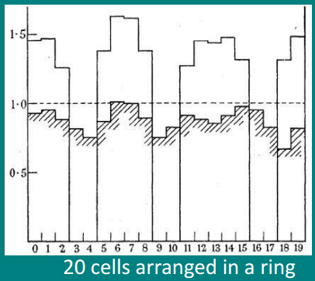
Turing A.M. The chemical basis of morphogenesis. Philosophical Transactions of the Royal Society of London, B237, 37-72 (1952).
Reaction-diffusion morphogenesis: a symmetry-breaking model?
An unstable equilibrium leads to initial random concentration of a morphogen (e.g. generic signaling molecule).
* leads to a morphogen wave at a specific concentration.
Physical evidence for instability phenomena in "morphogenesis“:
* Clark Maxwell (Stability of Motion of Saturn's Rings).
* Lord Rayleigh (viscous liquid under capillary force).

Slide 41
How can we emulate such a complex process? Using a multitude of data and an informatics framework

Slide 42
RDF Framework
Informatics problem: How to build a data structure from semantic data?
* cells would have semantic tags which act as metadata.
* tags organized into a data structure that can be mapped to a tree structure.
* use the resource description frame (RDF) framework, based on XML.

Slide 43
RDF Framework
Informatics problem: How to build a data structure from semantic data?
* cells would have semantic tags which act as metadata.
* tags organized into a data structure that can be mapped to a tree structure.
* use the resource description frame (RDF) framework, based on XML.
Proposed solution: n-Quad data structure (extensible to new data types and sets of relationships).
* standard 3-tuples of information + context. For example:
* spatial 3-tuple (x,y,z): describes the location of a particular C. elegans cell in space.
* temporal 3-tuple: cell size (i), division event number (t), and the spatial angle of differentiation (θ,φ).

Slide 44
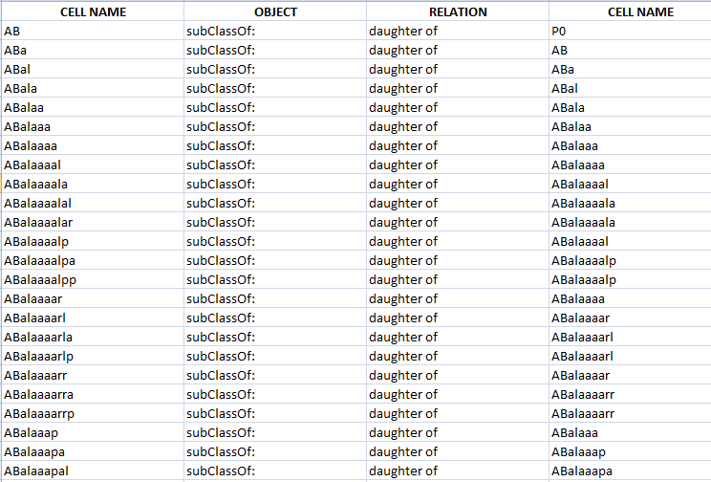
Metadata as a Means to Relate Objects
How to relate objects in the embryo, two at a time.

Slide 45
Metadata as a Means to Relate Objects
Relation field
(‘daughter of’ is a descendent node in data structure)
How to relate objects in the embryo, two at a time.
Object field
(‘subClassOf:’ is a datatype, specifies the kind of cell)

Slide 46
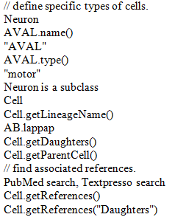
Defining objects:
* In this example (pseudo-code), we take a neuron from the OpenWorm project.
* Neuron is a subclass of “cell”, and its cell identity (lineage) is “AB.lappap”.
* There is one type of “Neuron” for this instance, defined as “motor”.

Slide 47
Defining objects:
* in this example (pseudo-code), we take a neuron from the OpenWorm project.
* neuron is a subclass of “cell”, and its cell identity (lineage) is “AB.lappap”.
* there is one type of “Neuron” for this instance, defined as “motor”.
What objects can be associated with:
* We can associate this particular cell with other objects (parents, daughters) and metadata (PubMed, Textpresso).

Slide 48
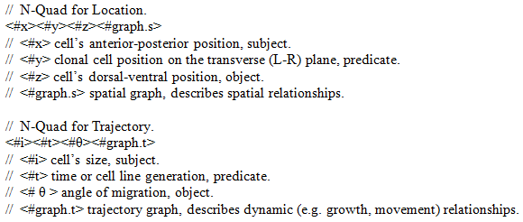
Pseudo-code showing the relational attributes of a differentiation tree:

Slide 49
Pseudo-code showing the relational attributes of a differentiation tree:
How to Visualize Graph:
* place each cell within a radial topology using semi-structured data.
* visualize using Unified Data Access (UDA) Layer protocol (PyMol).
* NetworkX proposed to integrate RDF and UDA.

Slide 50
Visualization of Data
Get a mock-up figure from Stephen

Slide 51
What is the potential for this approach? Does this mean we fully understand development now? NO (but)…..

Slide 52
Future Vision (the 25,000 m view)
What can be done with DevoWorm? And why do it, anyways?
* incorporate developmental principles into the scheme of OpenWorm emulation.
* possible greater understanding of neurophysiology and behavior of C. elegans by connecting to its development
* extensible platform serves as a basis for future simulation.
What features could be added in the future?
* genetic complexity (e.g. evolutionary developmental algorithms, detailed next-gen sequencing data).
* experimental prediction engine (e.g. what happens when a specific manipulation is performed?)
* biological diversity (e.g. emulation of males, hermaphrodites and mutants).

Slide 53
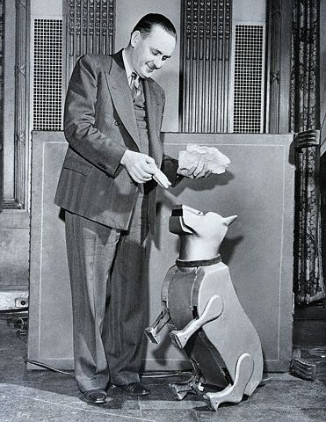
Sparko the Robotic Dog, Cybernetic Zoo
COURTESY: http://cyberneticzoo.com/tag/mechanical-animal/
Nice body, but how did it get there?

Slide 54
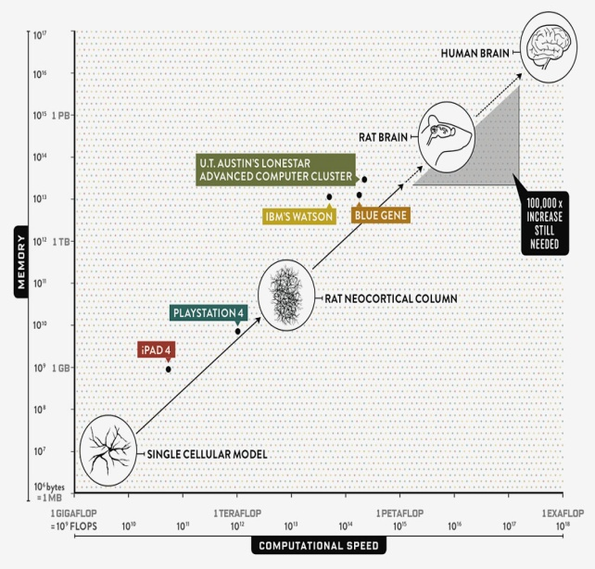
Nice goal, but how do you get there?
Throw enough supercomputing at a wall,
get a human brain?
COURTESY: http://www.wired.com/2013/05/neurologist-markam-human-brain/all/

Slide 55
Missing components to traditional whole-organism emulation:
DevoWorm can address some of these issues.
* what does “not biological enough” mean?
* developmental processes, generativity, stochasticity.
* organizing principles are not hard rules (or constraints).

Slide 56
Making models (in this case, R-D Morphogenesis) more biologically realistic:
* abstractions are meant to compress a complex biological process to a workable description.
Model of R-D Morphogenesis is abstraction to a dynamical chemical process. What about the other dimensions of morphogenesis?
* modeling the effects of local self-enhancement and long-range inhibition in Hydra embryos.

Slide 57
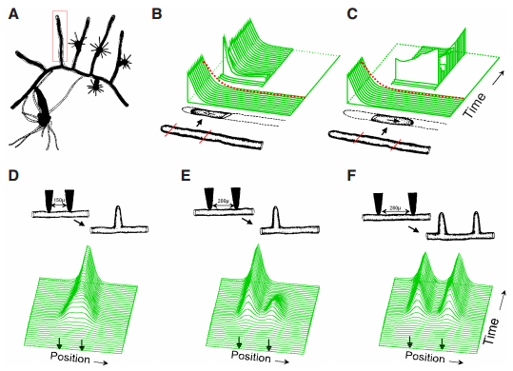
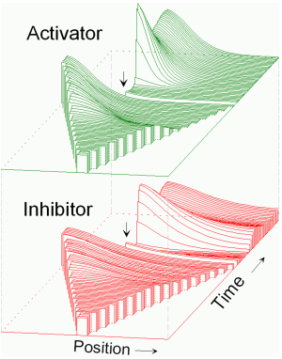
Making models (in this case, R-D Morphogenesis) more biologically realistic:
Model of R-D Morphogenesis is abstraction to a dynamical chemical process. What about the other dimensions of morphogenesis?
Model approximates Nodal/Lefty2 gene expression interaction to enable autocatalytic interactions.
COURTESY: Meinhardt, H. Modeling pattern formation in hydra: a route to understand essential steps in development. International Journal of Developmental Biology, 56(6-8), 447-462 (2012).

Slide 58
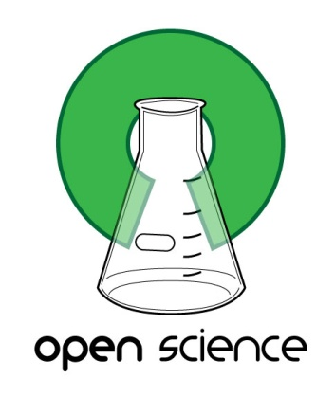
DevoWorm is an Open Science and collaborative endeavor. Thanks go to:
* OpenWorm group for programming support.
* Sulston research group for semantic data.
* White research group for microscopy data.
* GEO database for gene expression data.
Your funding
initiative here!
Your funding
initiative here!

